Slide 1


EMIRATES NBD PRIVATE BANKING
Projects done June 2022 - September 2023

Slide 2




PRIVATE BANKING SERVICES EDM

Slide 3




TRUST AND ESTATE PLANNING EDM

Slide 4

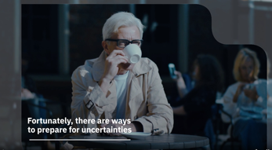


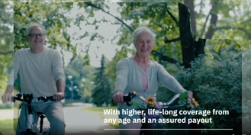

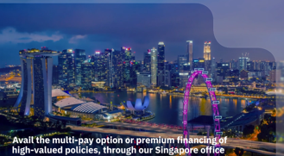


UNIVERSAL LIFE INSURANCE VIDEO
Click here to watch the video

Slide 5






UNIVERSAL LIFE INSURANCE CAROUSEL

Slide 6

PRINT ADVERT

Slide 7


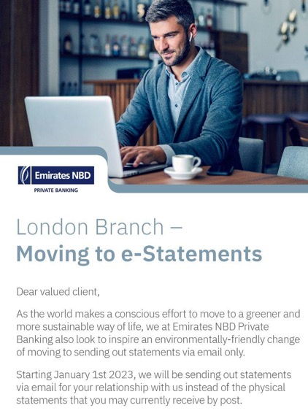

PRIVATE BANKING E-STATEMENT EDM

Slide 8



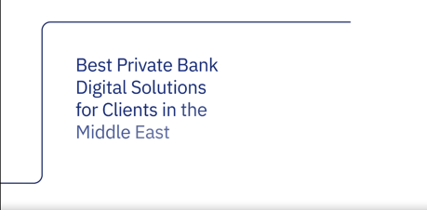


GLOBAL FINANCE AWARDS VIDEO
Click here to watch the video

Slide 9

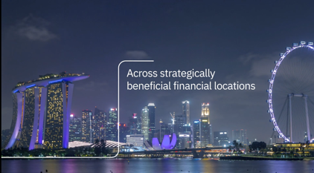



OFFSHORE BOOKING CENTRES VIDEO
Click here to watch the video.

Slide 10





WEALTHBRIEFING MENA AWARDS VIDEO
Click here to watch the video

Slide 11




ONLINE AND MOBILE BANKING EDM

Slide 12
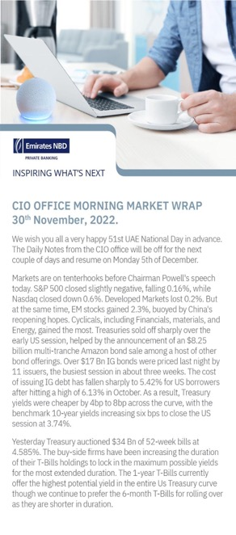
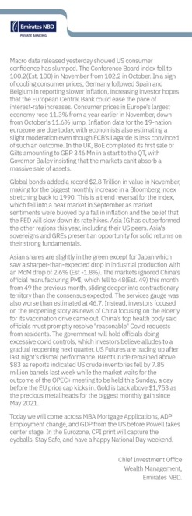
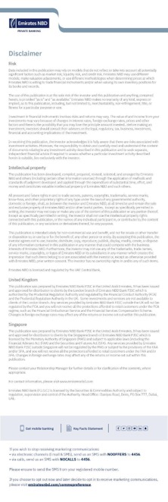
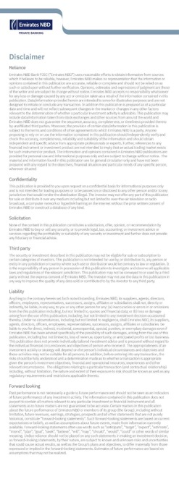
CIO DAILY ALEXA TEMPLATE DOCUMENT

Slide 13





ENBD 2023 PRIVATE BANKING VIDEOS
REFRESHED FOR LINKEDIN
INVESTMENT ADVISORY
CLICK HERE
CIO OFFICE
CLICK HERE
LENDING SOLUTIONS
CLICK HERE
OFFSHORE
CLICK HERE
TRUST AND ESTATE PLANNING
CLICK HERE

Slide 14

ENBD 2023 PRIVATE BANKING VIDEOS
REFRESHED FOR LINKEDIN
TRUST AND ESTATE PLANNING
ENGLISH
CLICK HERE
TRUST AND ESTATE PLANNING
ARABIC
CLICK HERE

Slide 15
ENBD DIFC TICKER BRANDING - SET 1
English
Arabic

Slide 16
ENBD DIFC TICKER BRANDING - SET 2
English
Arabic

Slide 17
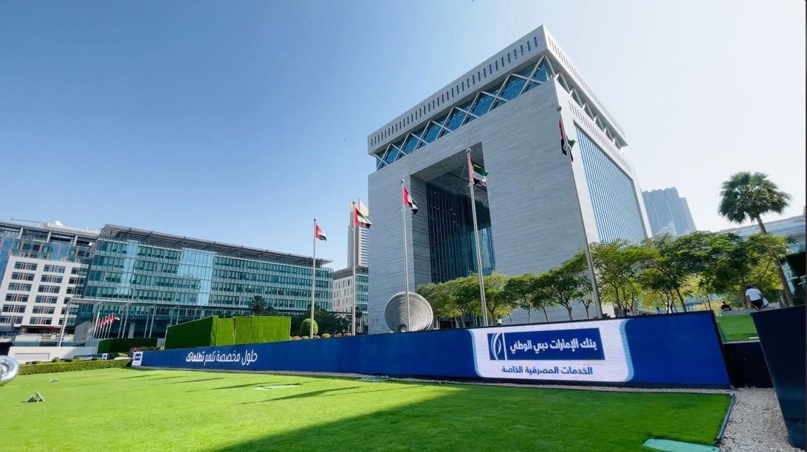
MOCKUP

Slide 18




ENBD DIFC GATE VILLAGE - VERTICAL AND HORIZONTAL
CLICK HERE
CLICK HERE
CLICK HERE
CLICK HERE

Slide 19
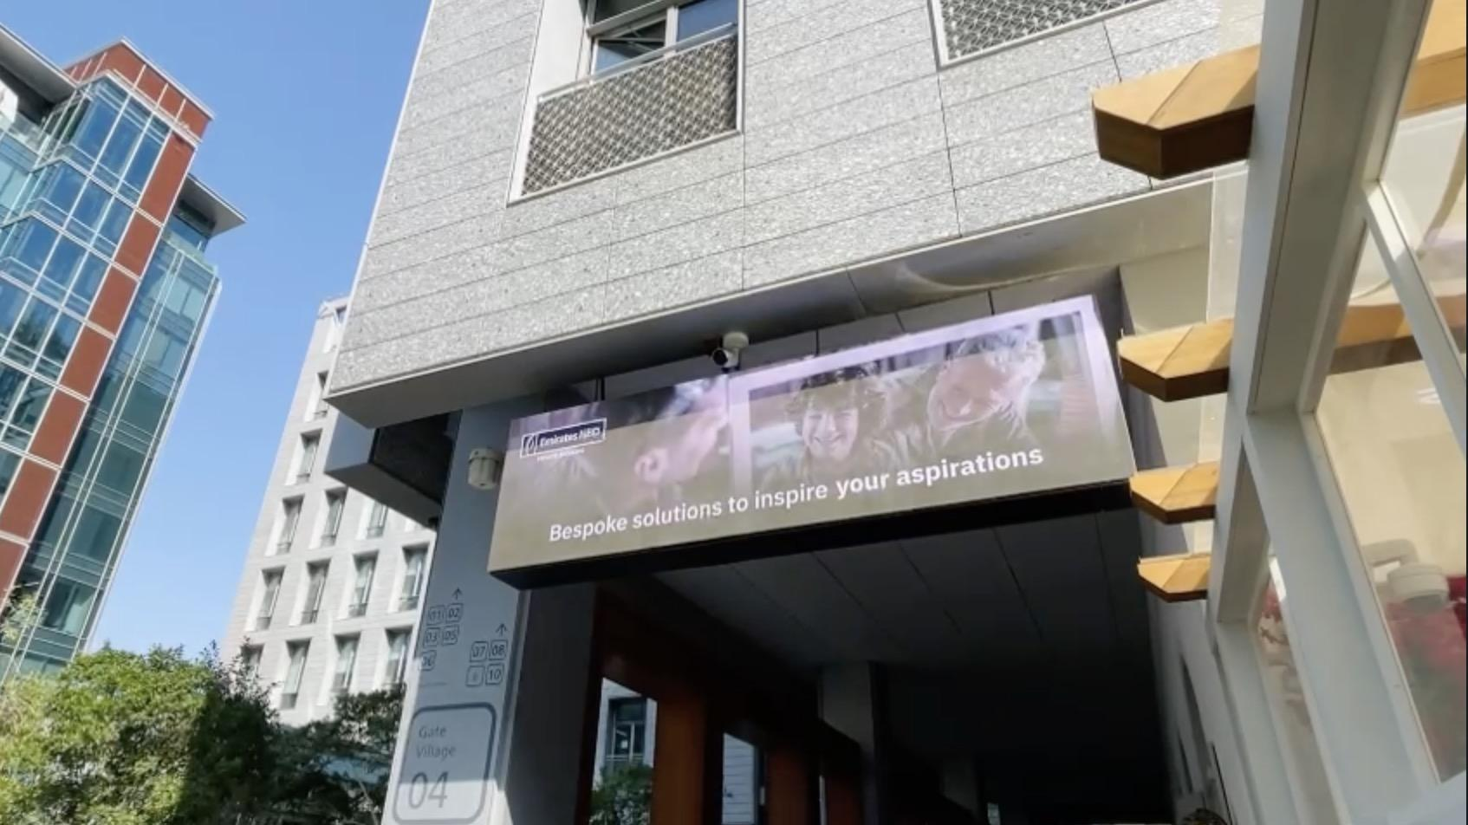
MOCKUP

Slide 20
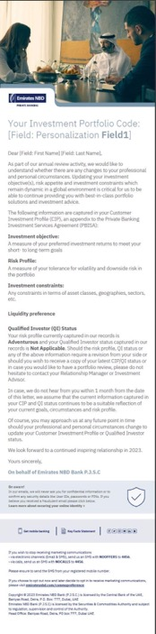

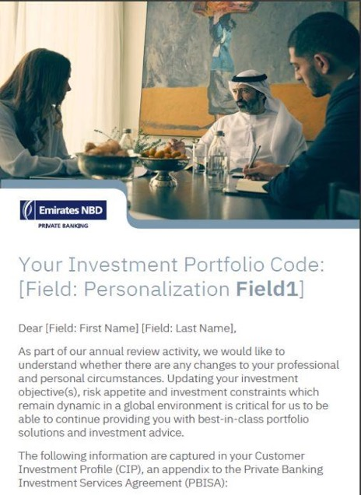

ENBD PB - ANNUAL INVESTOR PROFILE EDMs :

Slide 21
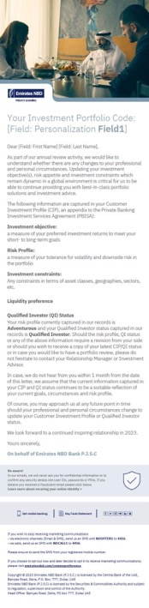

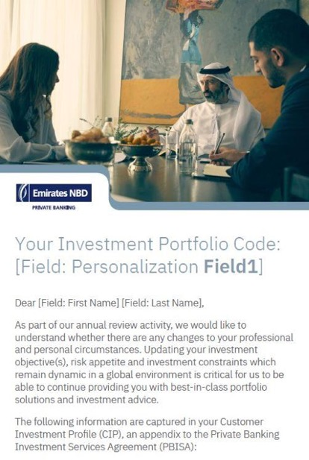
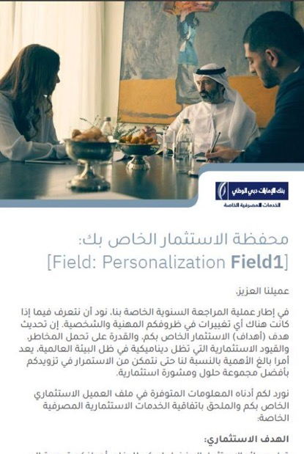
ENBD PB - ANNUAL INVESTOR PROFILE EDMs

Slide 22




ENBD PB - ANNUAL INVESTOR PROFILE EDMs

Slide 23
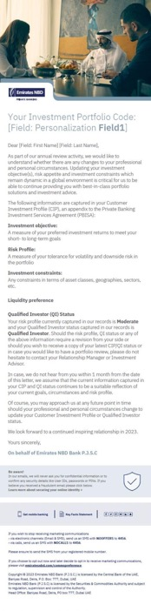

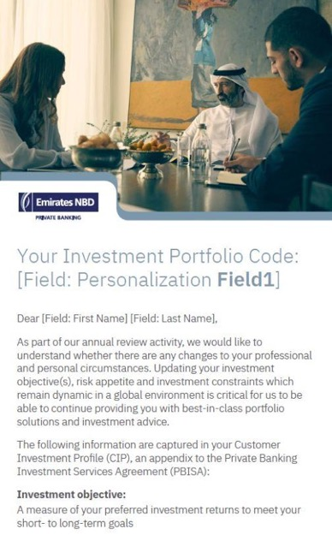

ENBD PB - ANNUAL INVESTOR PROFILE EDMs

Slide 24




ENBD PB - ANNUAL INVESTOR PROFILE EDMs

Slide 25
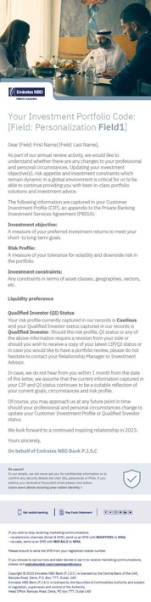


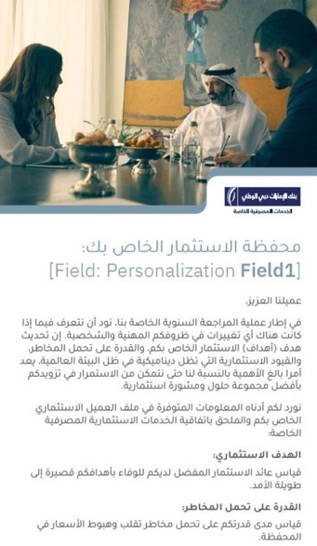
ENBD PB - ANNUAL INVESTOR PROFILE EDMs

Slide 26
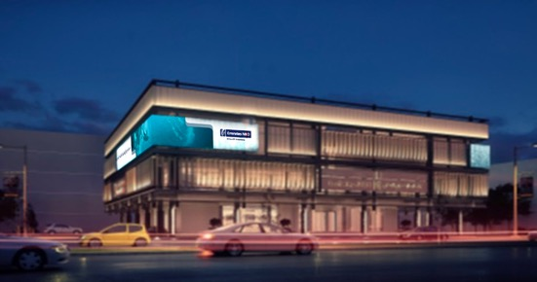
ENBD PB - VIDEOS FOR ENBD CITY WALK GOLD BRANCH
VIDEOS FOR FACADE
English
CLICK HERE
Arabic
CLICK HERE

Slide 27
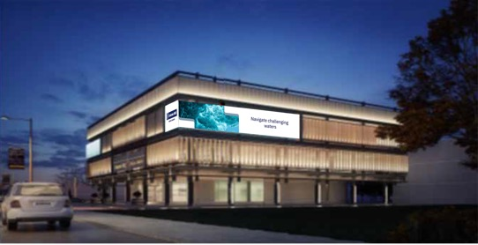
ENBD PB - VIDEOS FOR ENBD CITY WALK GOLD BRANCH
VIDEOS FOR FACADE
English
CLICK HERE
Arabic
CLICK HERE

Slide 28


VIDEO FOR TV SCREENS
CLICK HERE
CLICK HERE

Slide 29


VIDEO FOR ELEVATOR SCREENS
CLICK HERE
CLICK HERE

Slide 30




TRUST AND PLANNING ESTATE EDMS (REFRESHED)

Slide 31
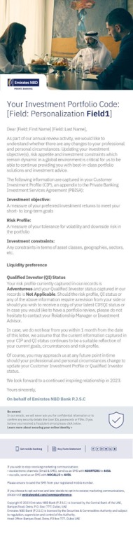

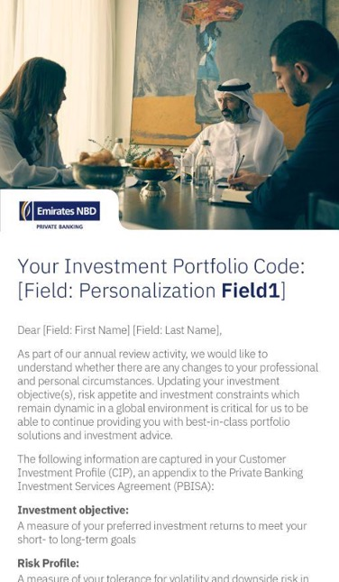
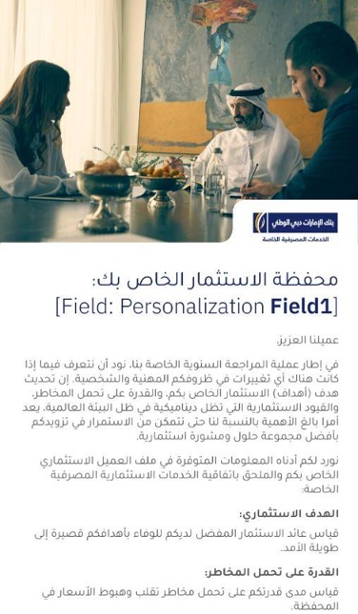
RM CHANGE AND INVESTMENT PROFILE EDMS

Slide 32



WEBSITE BANNERS

Slide 33




AWARDS CAROUSEL

Slide 34











EXTERNAL ASSET MANAGEMENT VIDEO
CLICK HERE TO VIEW THE VIDEO

Slide 35






EXTERNAL ASSET MANAGEMENT CAROUSEL

Slide 36


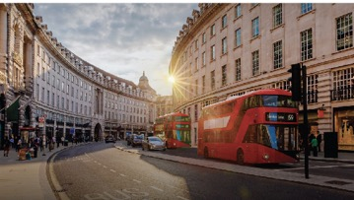



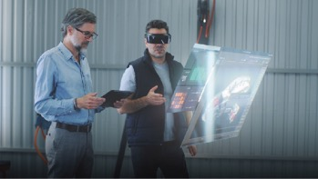
EXTERNAL ASSET MANAGEMENT CAROUSEL
PRIVATE BANKING SERVICES - VIDEOS FOR SOCIAL MEDIA
Trust and estate planning
Lending solutions
Real estate advisory
Chief Investment Office
Click here to view video
Click here to view video
Click here to view video
Click here to view video
Offshore booking centres
External asset management
Investment advisory services
Click here to view the video
Click here to view the video
Click here to view the video

Slide 37
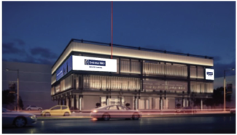
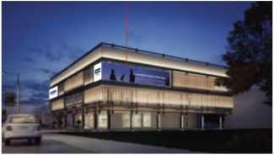
EXTERNAL ASSET MANAGEMENT CAROUSEL
ENBD PB - CITY WALK GOLD BRANCH VIDEOS
Click here to view English video
Click here to view Arabic video

Slide 38


EXTERNAL ASSET MANAGEMENT CAROUSEL
ENBD PB - CITY WALK GOLD BRANCH VIDEOS
TV screens

Slide 39


EXTERNAL ASSET MANAGEMENT CAROUSEL
ENBD PB - CITY WALK GOLD BRANCH VIDEOS
Elevator Screens

Slide 40
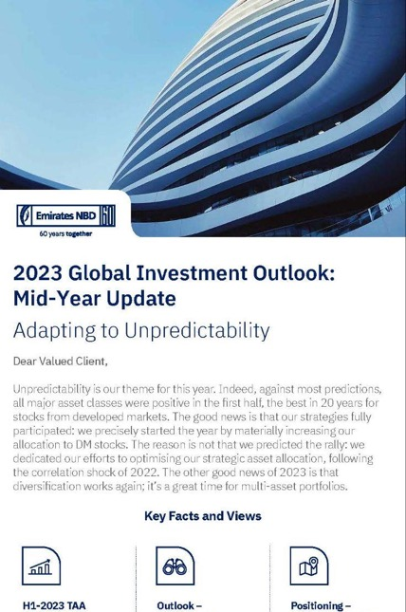

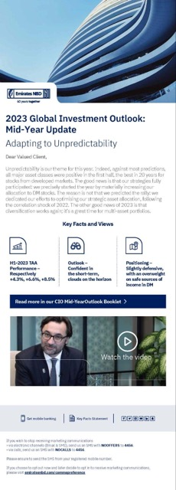
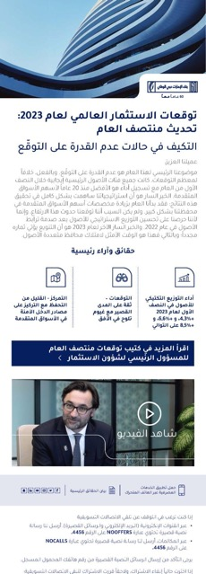
EXTERNAL ASSET MANAGEMENT CAROUSEL
MID-YEAR OUTLOOK - EDMs

Slide 41
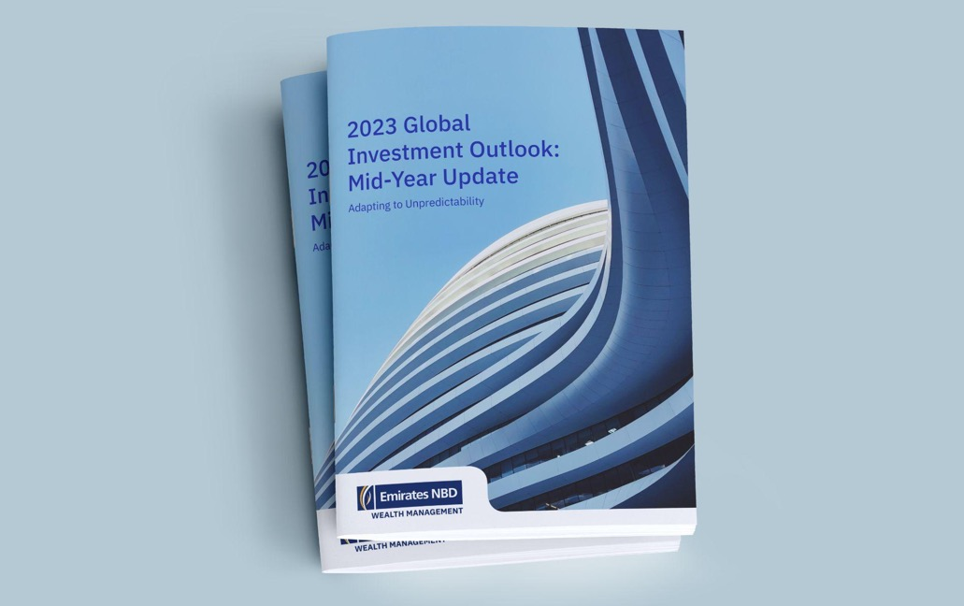
EXTERNAL ASSET MANAGEMENT CAROUSEL
CIO BOOKET

Slide 42


EXTERNAL ASSET MANAGEMENT CAROUSEL
ENBD LONDON - CAPABILITIES CAROUSELS

Slide 43

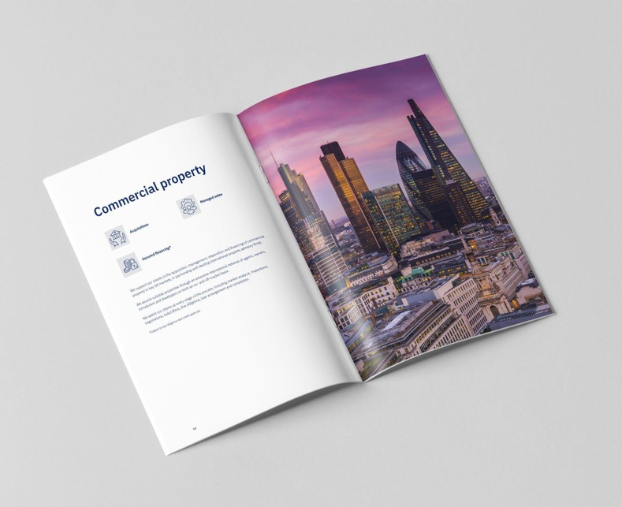
EXTERNAL ASSET MANAGEMENT CAROUSEL
ENBD LONDON - REAL ESTATE ADVISORY SERVICES BROCHURE

Slide 44
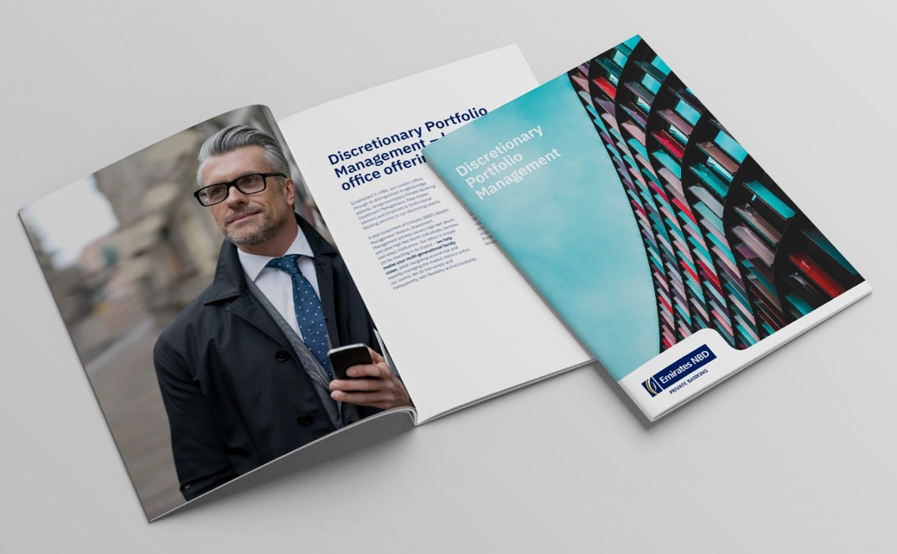
EXTERNAL ASSET MANAGEMENT CAROUSEL
ENBD LONDON - DPM BROCHURE

Slide 45


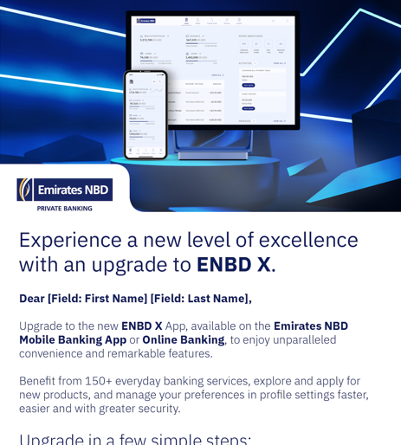
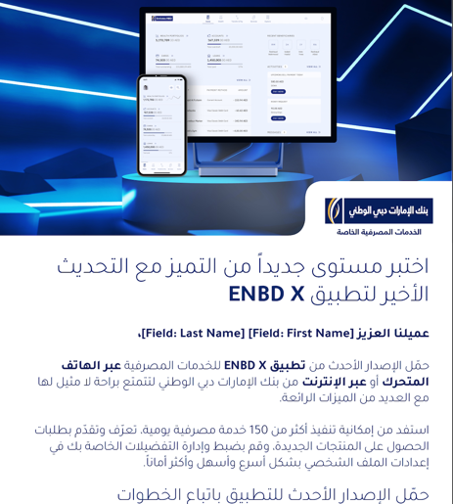
EXTERNAL ASSET MANAGEMENT CAROUSEL
ENBD X EDMs - EXISTING CLIENTS

Slide 46


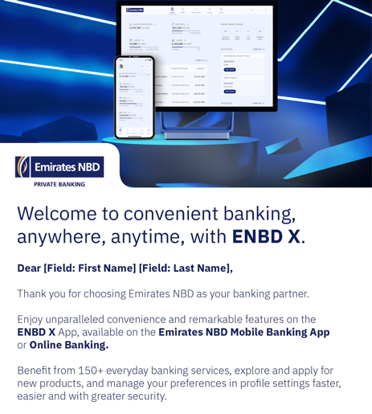
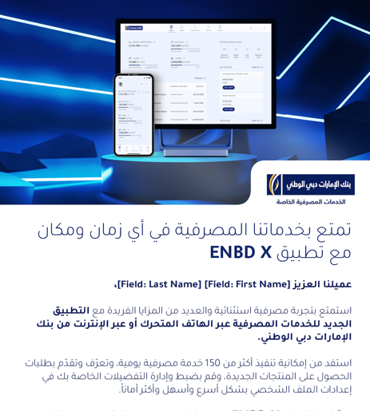
EXTERNAL ASSET MANAGEMENT CAROUSEL
ENBD X EDMs - NEW CLIENTS

Slide 47
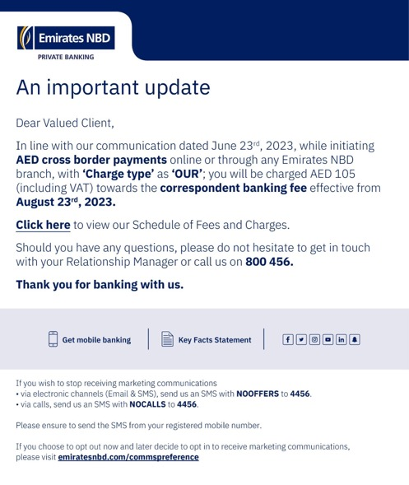
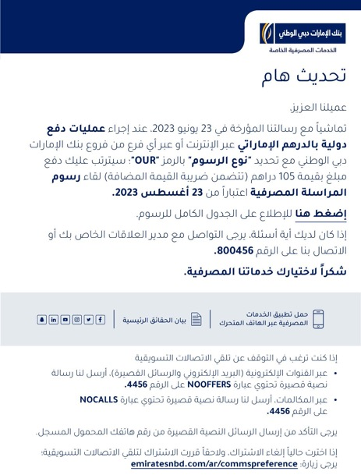
EXTERNAL ASSET MANAGEMENT CAROUSEL
ENBD PB - IMPORTANT UPDATES eDMs

Slide 48

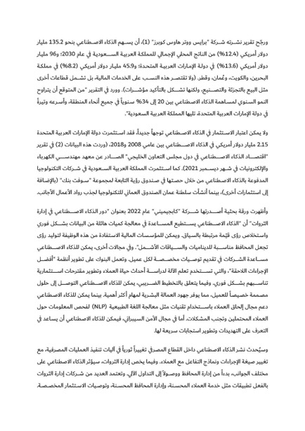
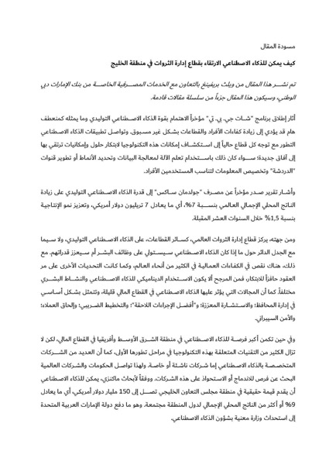
EXTERNAL ASSET MANAGEMENT CAROUSEL
ENBD PB - WEALTHBRIEFING THOUGHT LEADERSHIP ARTICLES
ARABIC

Slide 49
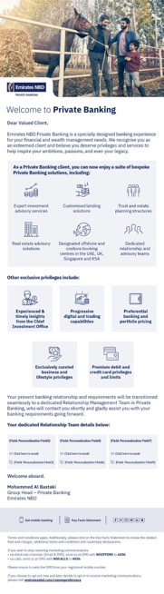
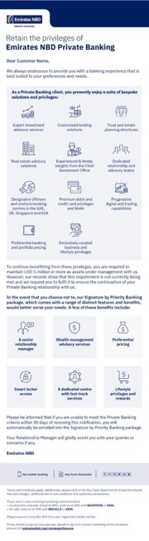
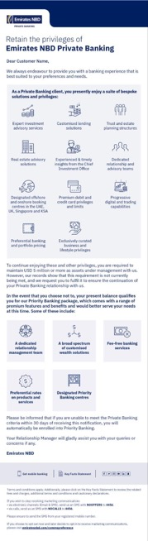
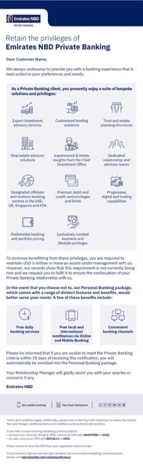
EXTERNAL ASSET MANAGEMENT CAROUSEL
ENBD PB MIGRATION eDMs ENGLISH (30 days)

Slide 50




EXTERNAL ASSET MANAGEMENT CAROUSEL
ENBD PB MIGRATION eDMs ARABIC (30 days)

Slide 51
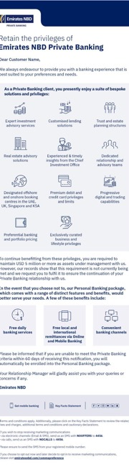

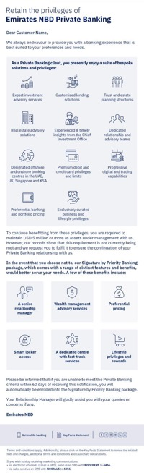
EXTERNAL ASSET MANAGEMENT CAROUSEL
ENBD PB MIGRATION eDMs ENGLISH (60 days)

Slide 52



EXTERNAL ASSET MANAGEMENT CAROUSEL
ENBD PB MIGRATION eDMs ARABIC (60 days)

Slide 53




EXTERNAL ASSET MANAGEMENT CAROUSEL
ENBD PB - BMW XM PROMO eDMs

Slide 54


EXTERNAL ASSET MANAGEMENT CAROUSEL
ENBD PB - MERCEDES EQ PROMO eDM

Slide 55


EXTERNAL ASSET MANAGEMENT CAROUSEL
ENBD PB - LETTERS TO FORBES TOP FAMILY BUSINESSES

Slide 56


EXTERNAL ASSET MANAGEMENT CAROUSEL
ENBD PB - DPM CAROUSEL

Slide 57




EXTERNAL ASSET MANAGEMENT CAROUSEL
ENBD PB - MEGA FX - INDIVIDUALS ACTIVATION eDMs

Slide 58




EXTERNAL ASSET MANAGEMENT CAROUSEL
ENBD PB - ONE CARD eDMs

Slide 59

ENBD PB - CAMPDEN EVENT VIDEO
CLICK HERE TO VIEW THE VIDEO

Slide 60














ENBD PB - CAMPDEN EVENT VIDEO
CLICK HERE TO VIEW THE VIDEO

Slide 61

ENBD PB - CAMPDEN EVENT TENT CARD

Slide 62
THANK YOU

